Slide 1
5.0. CONVENTION AND EVENT MANAGEMENT
EXECUTIVE DIPLOME IN HOSPITALITY MANAGEMENT

Slide 2
5.1. Meetings, Incentive Travel,Conventions, Exhibitions and Event Management
Objectives :
Name the hospitality industry associations
Describe the various types of meetings
Explain the difference between meetings, expositions, and conventions
Describe the role of a meeting planner
Explain the primary responsibilities of a convention and visitor’s bureau or authority
List the steps in event management

Slide 3
5.2. MICE (Meetings, Incentives, Convention and Exhibition)
MICE is used to refer to a particular type of tourism in which large groups, usually planned well in advance, are brought together for some particular purpose. MICE tourism usually includes a well-planned agenda centered around a particular theme or topic, such as profession trade organization, a special interest group or an educational topic. Such tourism is often a specialized area with its own exhibition

Slide 4
5.3. Meeting
Meeting –Brings people together for the purpose of exchanging information
An event booked at a hotel, convention center or any other venue dedicated to such gatherings.

Slide 5
5.3.1 Meeting covers the following:
1.Lecture (one presentation),
2.Seminar (typically several presentations, small audience, one day),
3.Conference (mid-size, one or more days),
4.Congress (large, several days),
5.Exhibition or trade show (with manned stands being visited by passers-by),
6.Workshop (smaller, with active participants), training course, team-building session and kick-off event.
7.Types of meetings

Slide 6
5.3.2. Types of meetings
(A). Clinic- workshop type educational experience in which attendees learn by doing. (small groups interacting with each other)○ Forum – an assembly for the discussion of common concerns. Usually, experts in a given field take the opposite sides of an issue in a panel discussion.
(B). Forum – an assembly for the discussion of common concerns. Usually, experts in a given field take the opposite sides of an issue in a panel discussion.
(C). Seminar – a lecture and a dialogue that allow participants to share experiences in a particular field. A seminar is guided by an expert discussion leader, usually 30 or fewer persons participates.
(D). Symposium - a meeting or conference for the discussion of some subject, especially a meeting at which several speakers talk on or discuss a topic before an audience.○A collection of opinions expressed or articles contributed by several persons on a given subject or topic.
(E). Workshop – meetings emphasizing interaction and exchange of information among a usually small number of participants.

Slide 7
5.4. Incentives
Incentive tourism is usually undertaken as a type of employee reward by a company or institution for targets met or exceeded, or a job well done. Unlike the other types of MICE tourism, incentive tourism is usually conducted purely for entertainment, rather than professional or educational purposes.

Slide 8
5.5. Convention
Is a gathering of individuals who meet at an arranged place and time in order to discuss or engage in some common interest. The most common conventions are based upon industry, profession.

Slide 9
5.6. Major Players in the convention Industry

Slide 10
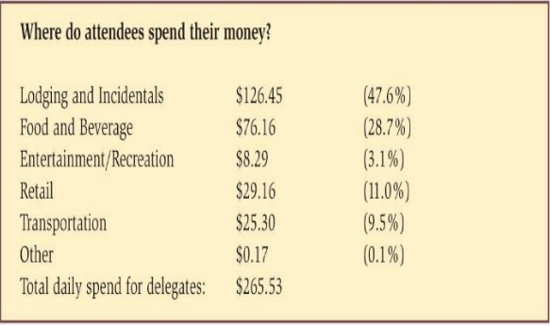

Slide 11
5.7. Exposition
A trade fair (trade show, trade exhibition or expo) is an exhibition organized so that companies in a specific industry can showcase and demonstrate their latest products, service, study activities of rivals and examine recent market trends and opportunities.

Slide 12
5.8. ROLE OF A MEETING PLANNER Successful event planners develop the following skills :
Verbal and written communications
Organization and time management
Project management and multi-tasking
Self-starter and team player
Understand Microsoft Office applications
Detail and deadline-oriented
Calm and personable under pressure
Negotiation
Budget management
Staff management
Marketing and public relations
Interpersonal skills with all levels of management

Slide 13
5.9. Successful event planners will develop following knowledge :
Venue selection
Catering
Production
Entertainment
Gifts○
Transportation
Lodging
Conference Services

Slide 14
5.10. Careers in event planning
Those who pursue a career in event planning come from a variety of professions and academic backgrounds. Many employers prefer a bachelors degree in hospitality management, business administration, marketing, public relations, or communications.

